Slide 1
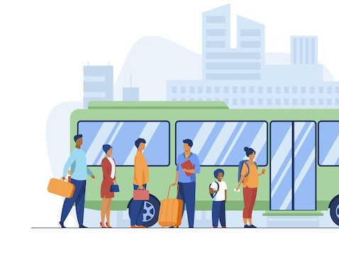
Public Transportation Forecast
Case Study
By
Shreya, Urvish, Adi, Salma

Slide 2
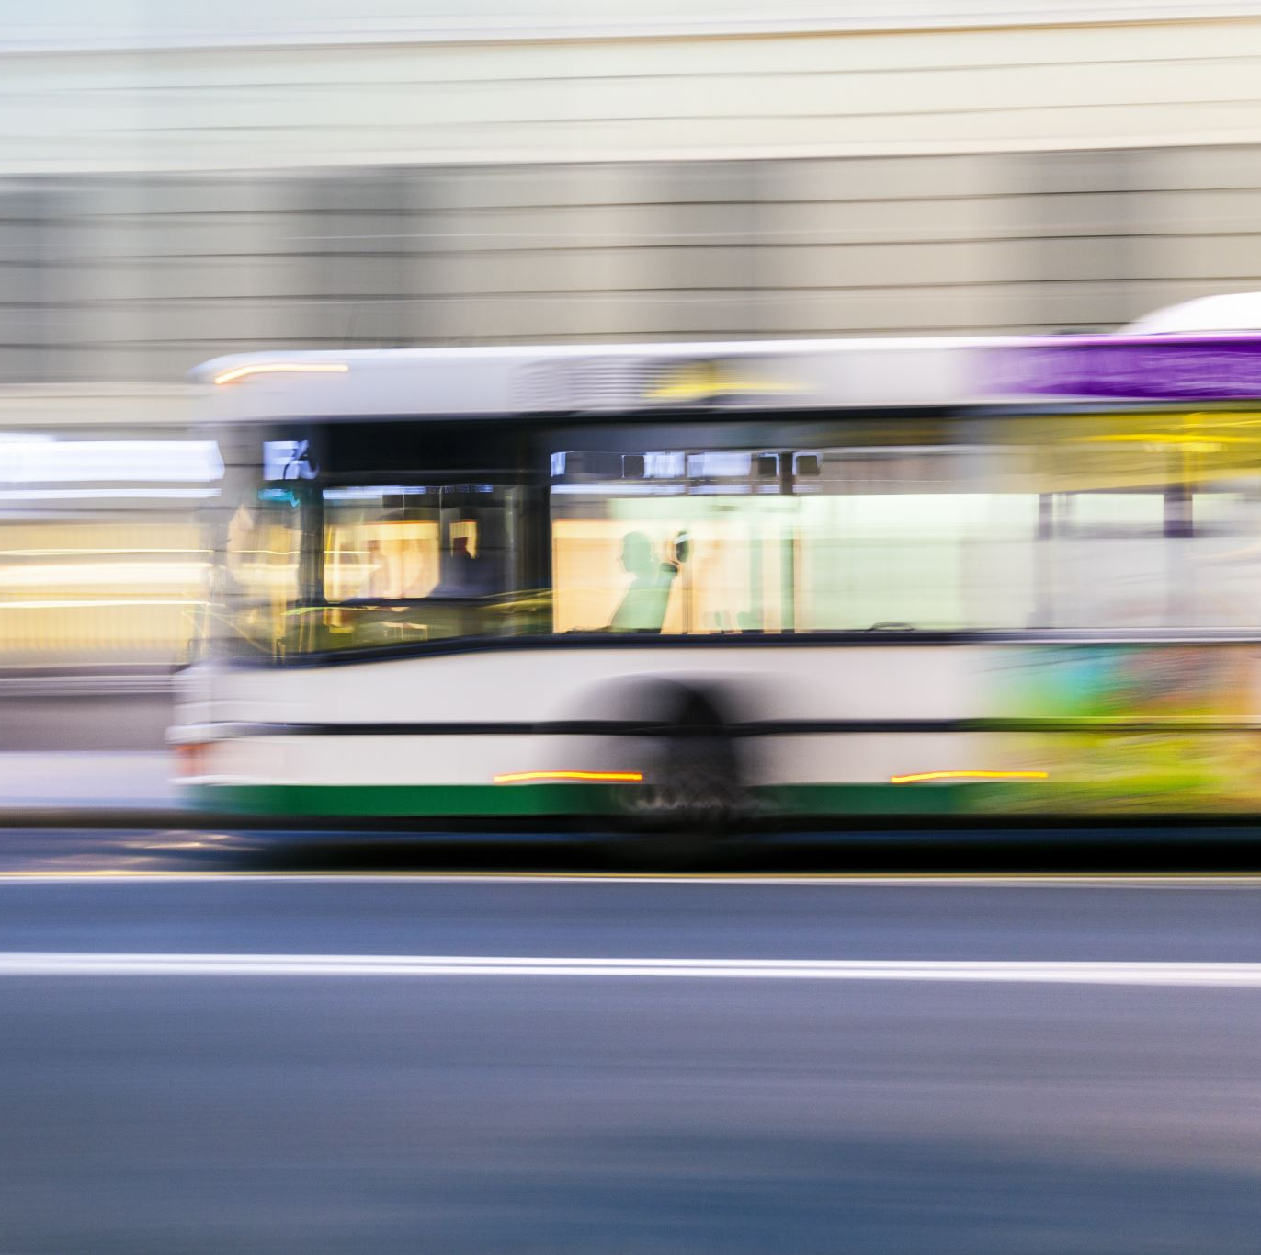
Problem Statement
To create a forecast of future demand in planning to acquire new buses and extend its terminals to meet expected demand.

Slide 3

Understanding Data
The dataset has 1323 rows observations and 3 variables with date, time and demand that shows instances of passengers every 15 minutes from 6:30 am to 10 pm every day. The date columns are converted into date time and calculating differences between dates.

Slide 4
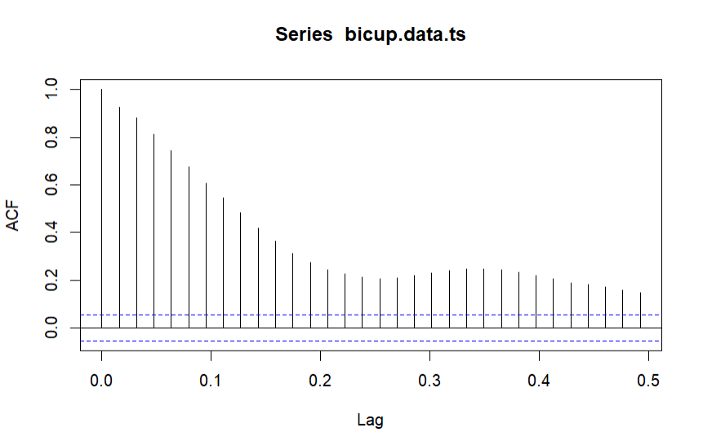
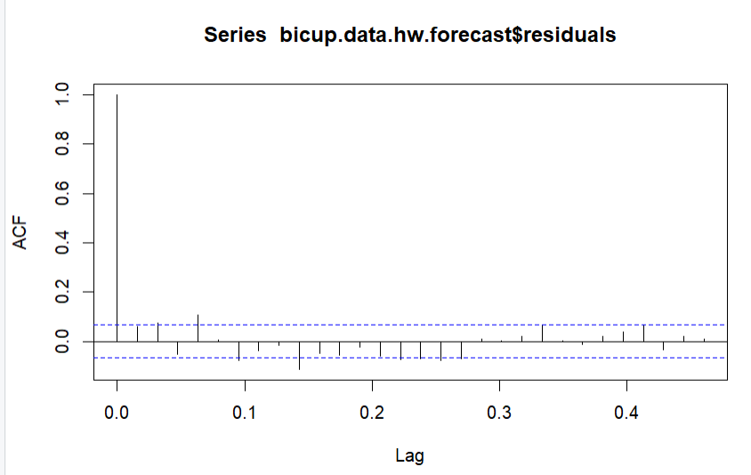
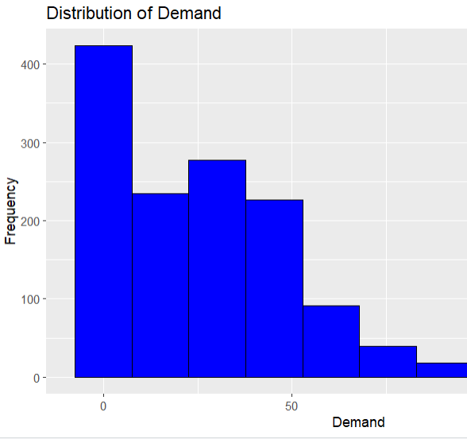
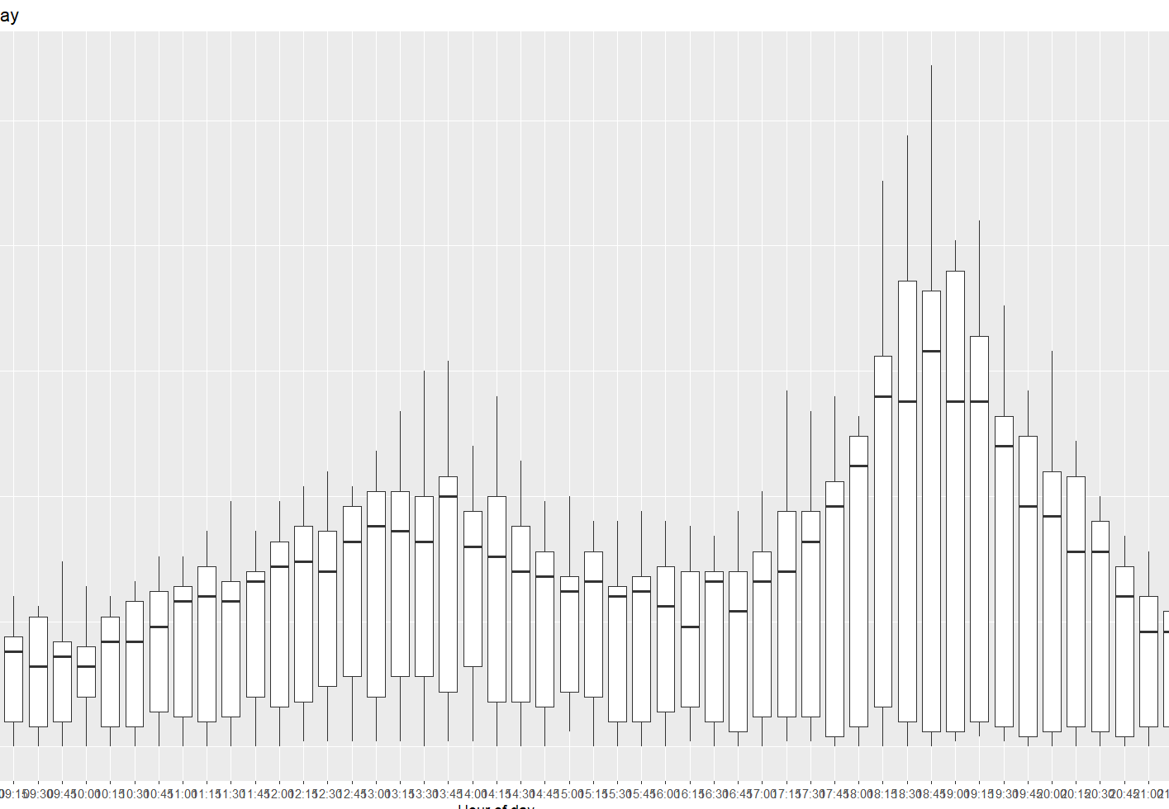
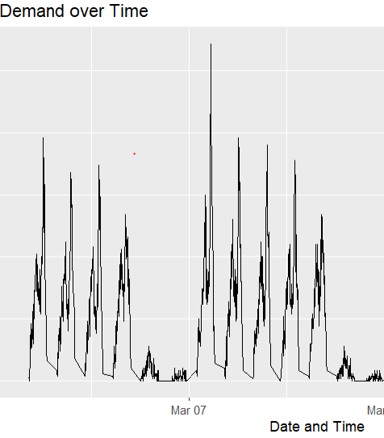
EDA

Slide 5
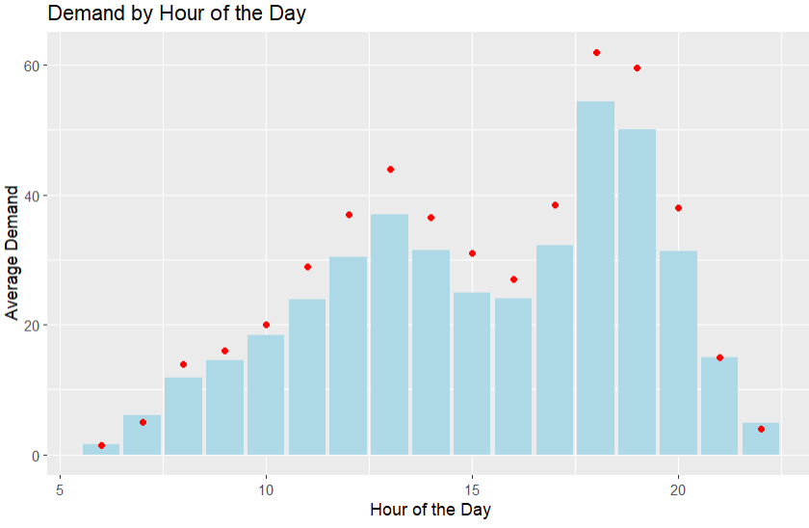
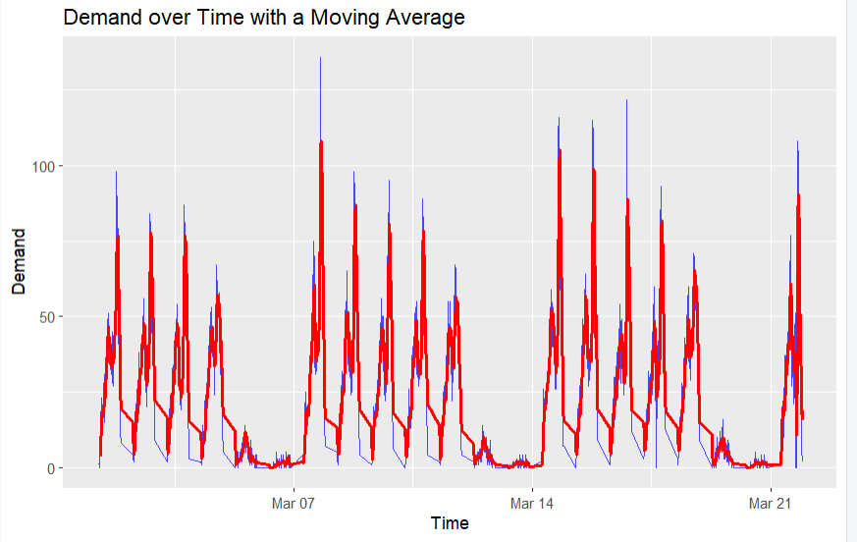
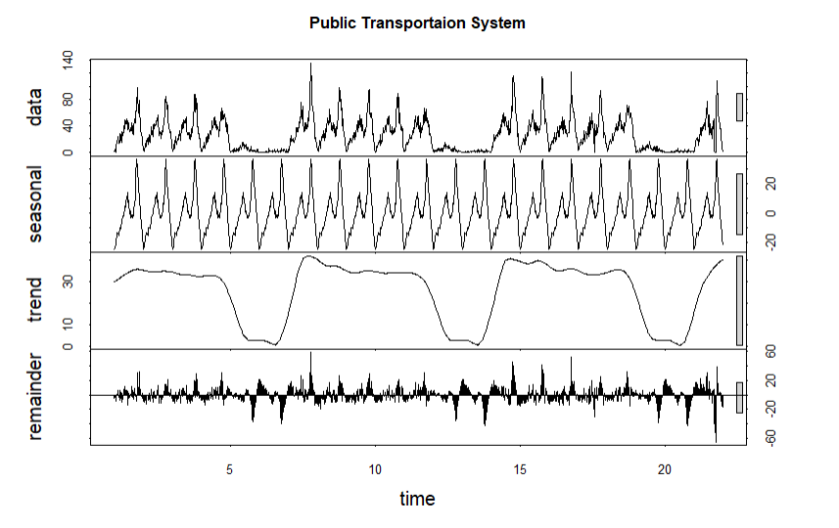
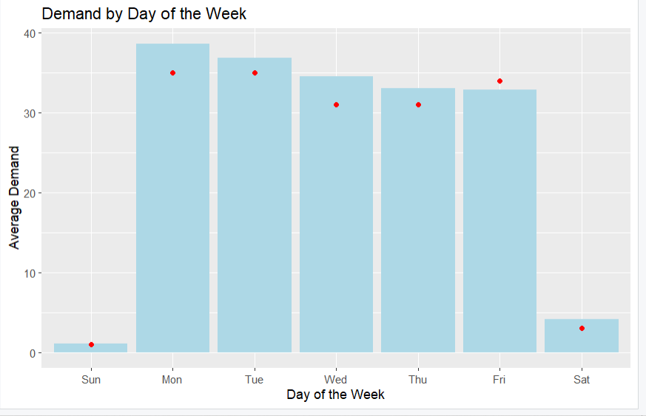
EDA

Slide 6
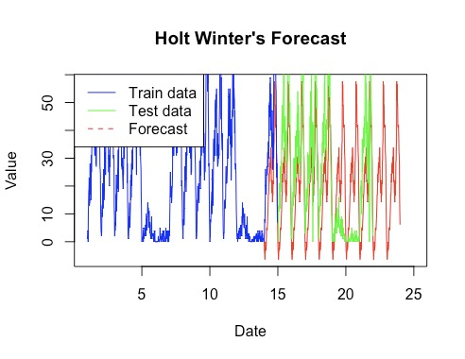
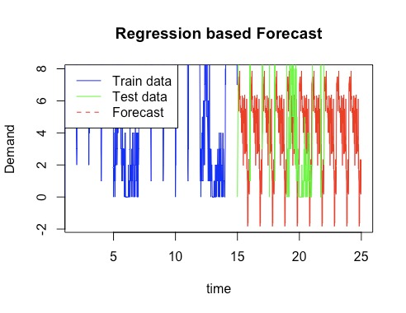
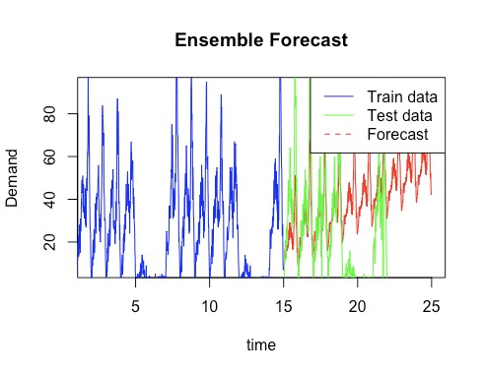
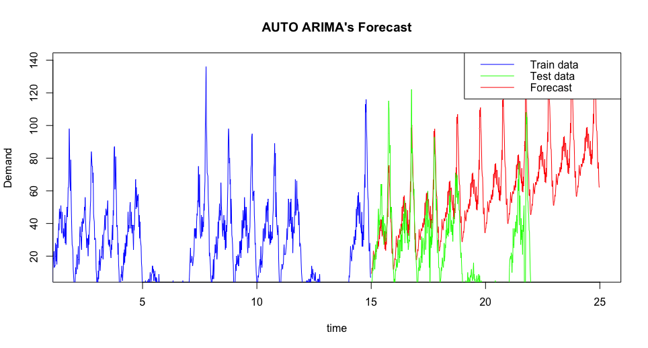

Slide 7
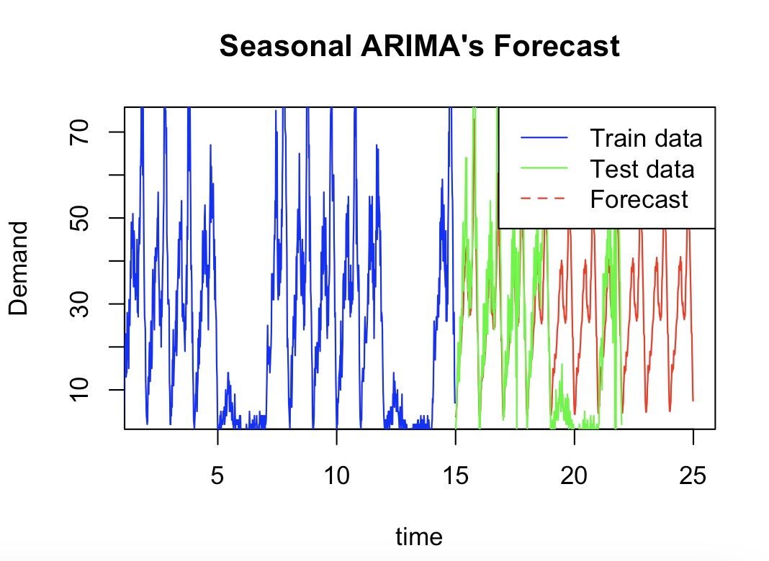
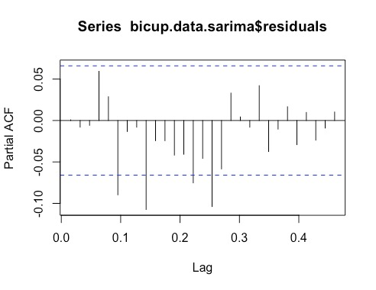
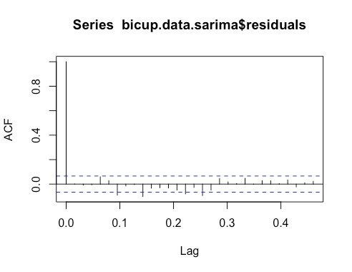
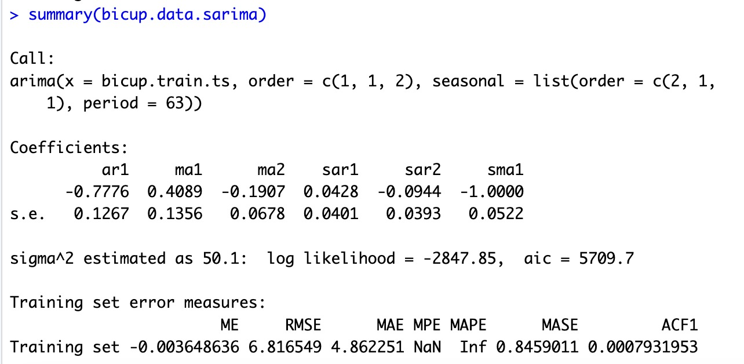

Slide 8
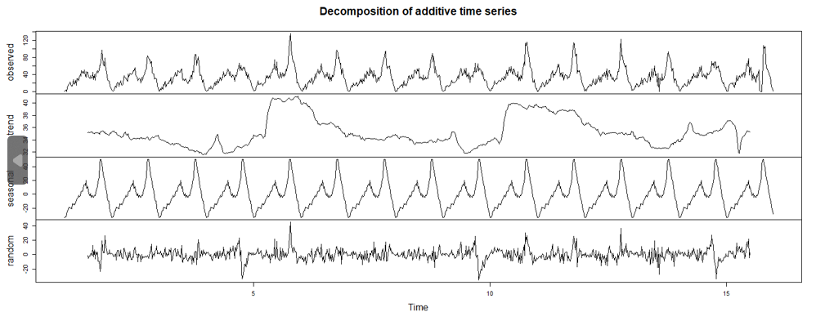
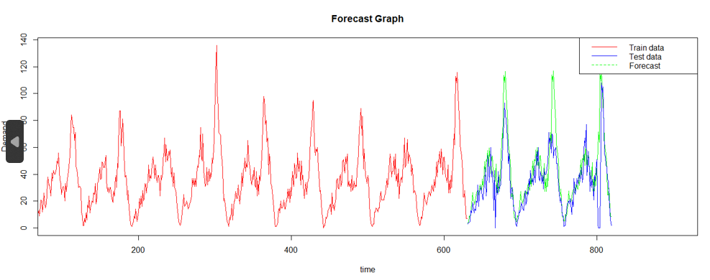

Slide 9
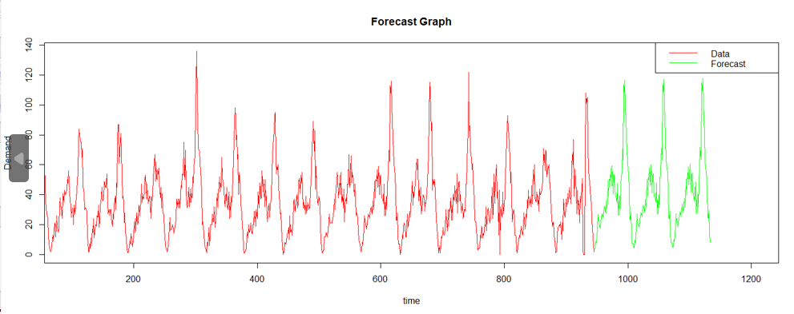
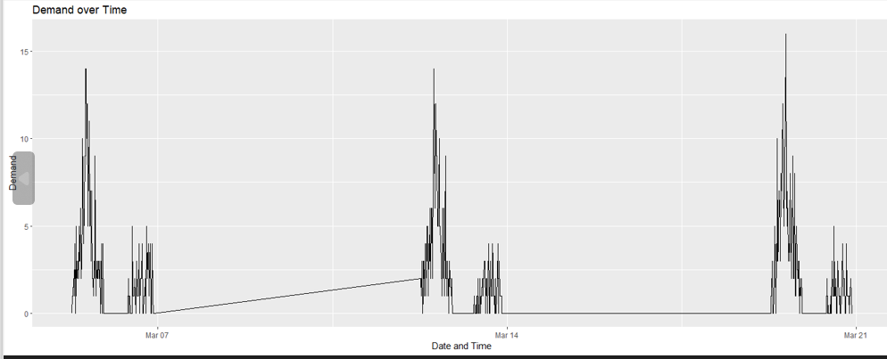

Slide 10
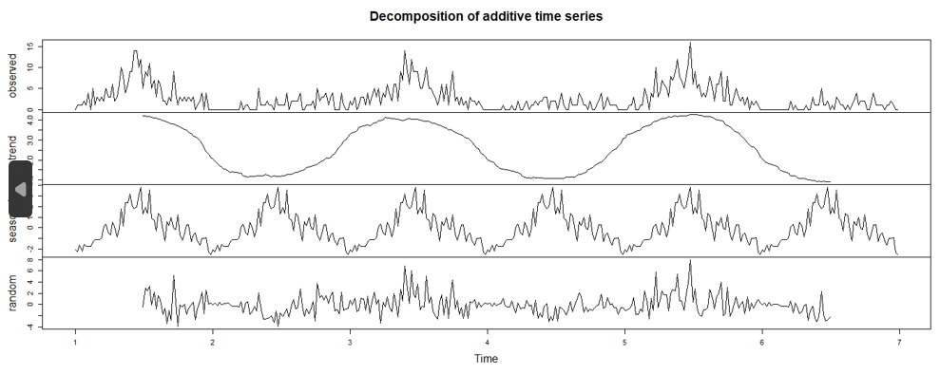
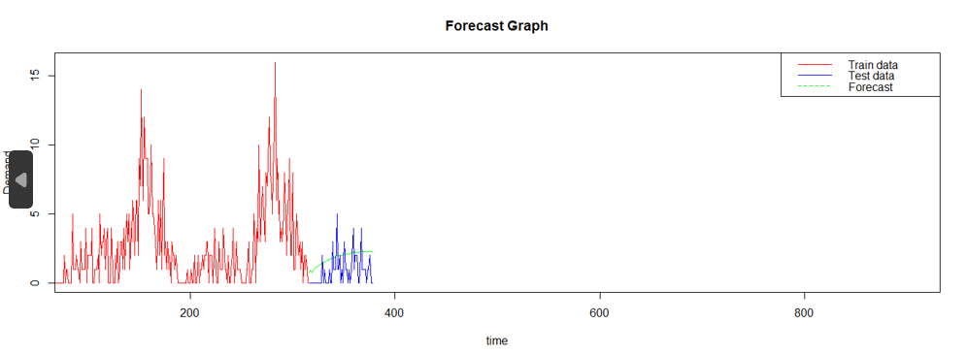

Slide 11
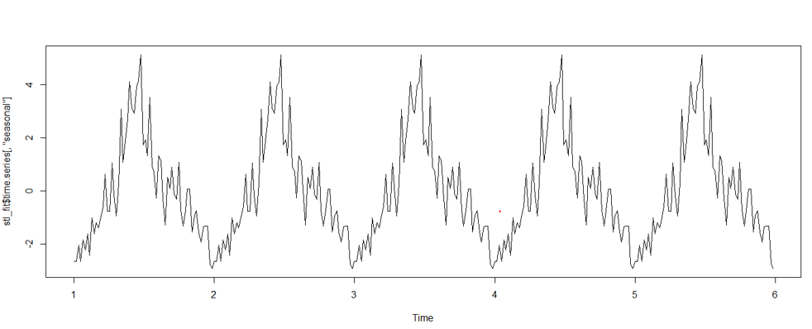
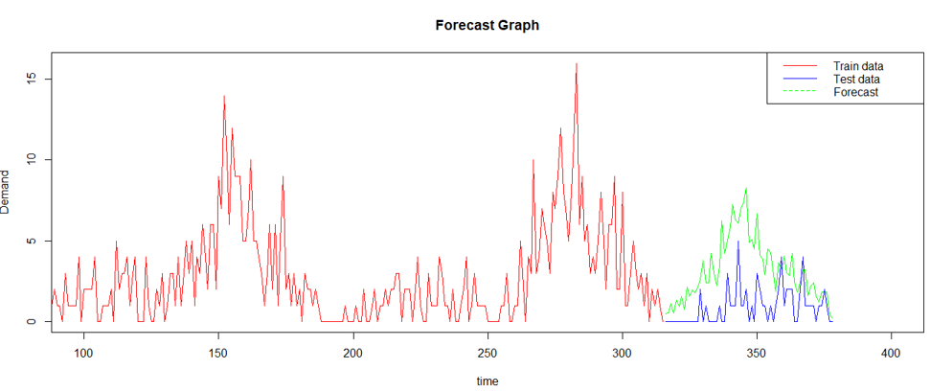

Slide 12
Major Findings
Number of passengers arriving at the terminal at the beginning of the week is higher than end of the week.
There is a consistent increase in demand every week as the number of passengers at the terminal increase from 100 passenger on 1st march to 120 passengers on 21st march with over 160 passengers on 8th March.
Distribution of demand is right skewed which means that majority of demand falls in certain range with low instances of high demand. This high demand can also be seasonal, which occurs during the first few days of the week and low demand for rest of the week.
Highest number of passengers arrive between 5:30 PM and 8:00 PM at the terminals.
The highest average number of passengers arrive at 6 PM followed by 7 PM and 1 PM. The least average number of passengers arrive at 6 AM.
The highest average demand for transportation is on Mondays followed by other working days, while least demand is on Sundays.
High autocorrelation at the lags indicate that data is nonstationary and needs to be addressed.
The forecasted data indicates that the demand continues the same pattern and numbers until 25th March 2005.

Slide 13
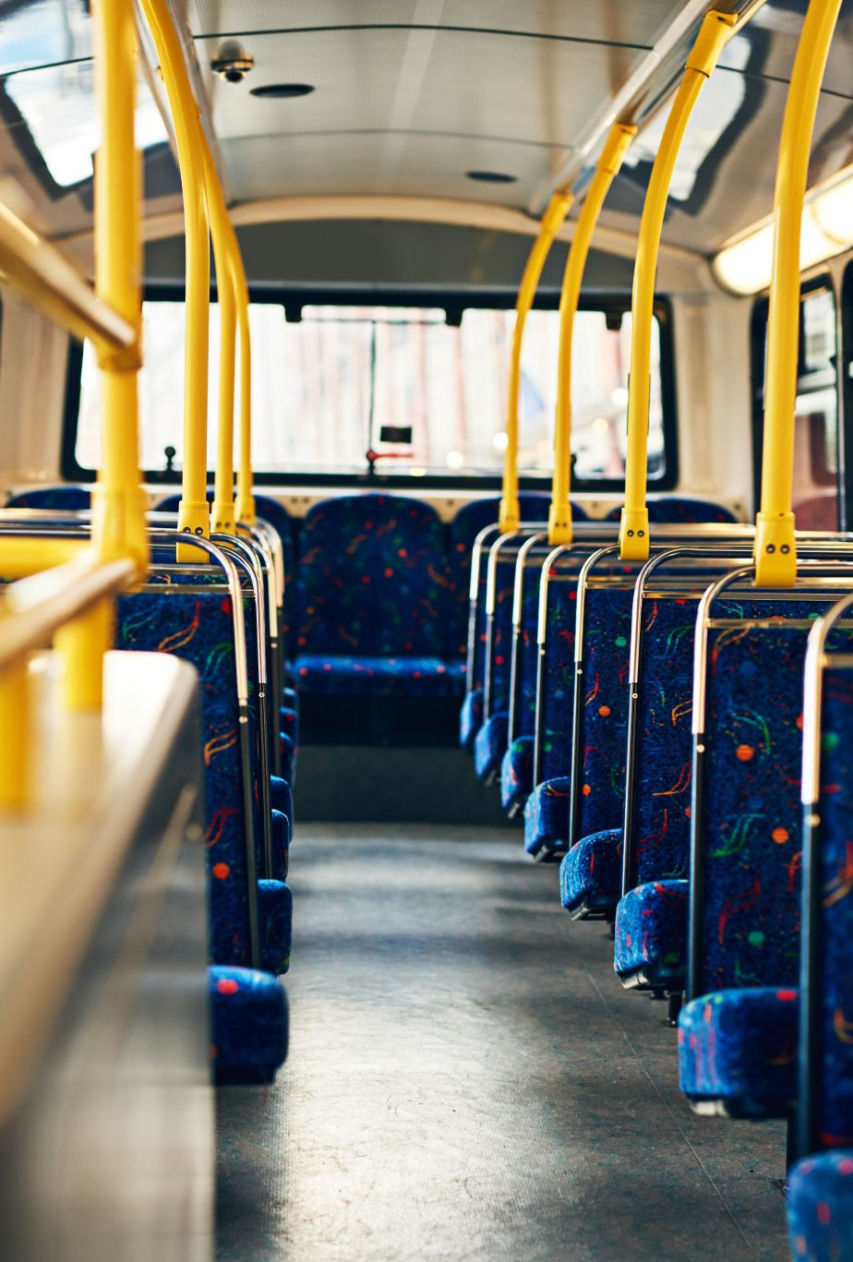
Recommendations
The number of buses should be increased during weekdays especially during the busiest times of the days at 6PM,7Pm and 8PM.
The number of buses can be decreased during weekends and can be utilized during busy hours to reduce cost.
The performance of the resources is to be tracked to make sure buses and terminals are well equipped for the changing demand.
Develop a contingency plan to support sudden spikes in the passengers arriving at the terminals.

